Slide 1

Reinforcement Learning-based Re-tasking
D. Josyula
Department of Computer Science
Bowie State University

Slide 2
D. Josyula – Brief Bio
Primary research area – Self correcting/ Self- adaptive autonomous systems
BSU Autonomous Technologies Lab (BSU@Lab)
Ongoing research:
Learning framework for Acoustic data classification, anomaly detection and autonomous adaptation
Novelty detection, computing in SWaP constrained edge devices, contested environments
Perturbation tolerance in collaborative target search
Conflicting information, theory of mind, expectation violations, limited communication

Slide 3
D. Josyula – Dissertations supervised
28 Sep. 2017
Behavior Oriented Intelligence, Kenneth M’Bale
12 May 2020
A study on managing and explaining concept drift, Tagrid Alshalali
5 Nov. 2020
One-shot adaptive classification in dynamic environments: A study using radio frequency waveforms, Marvin Conn
28 Sep. 2021
Data Implantation – A novel method for handling dataset imbalance for rare events detection in machine learning, Francis Onodueze
3 May 2022
A two-level filter learner (TLFL): An approach to train predictive models for noisy datasets, Eman Allogmani
10 May 2023
Long-Term Dependency Margin Maximization Model (LTDM3): Dealing with Concept Drift in Personalized Learning Systems, Bander Allogmany

Slide 4
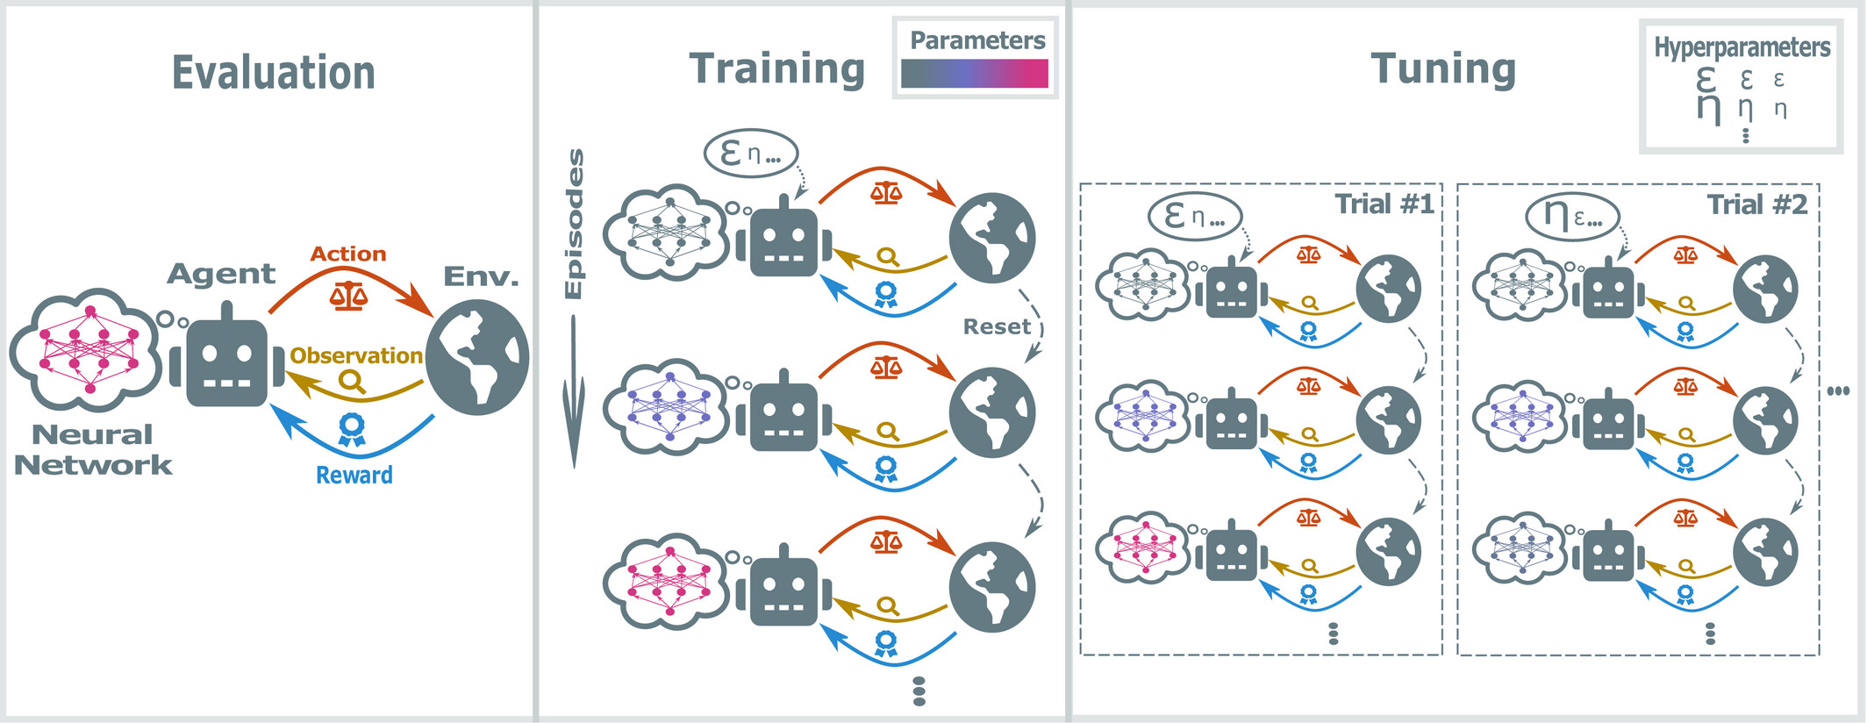
Deep RL for CoA Re-evaluation
Notes:
Deep reinforcement learning: A deep RL agent uses a neural network to select an action in response to an observation of the environment and receives a reward from the environment as a result.
During training, the agent tries to maximize its cumulative reward by interacting with the environment and learning from experience.
In the RL loop, the agent performs an action, then the environment returns a reward and an observation of the environment's state. The agent-environment loop continues until the environment reaches a terminal state, after which the environment will reset, causing a new episode to begin.
Across training episodes, the agent will continually update the parameters in its neural network, so that the agent will select better actions.

Slide 5
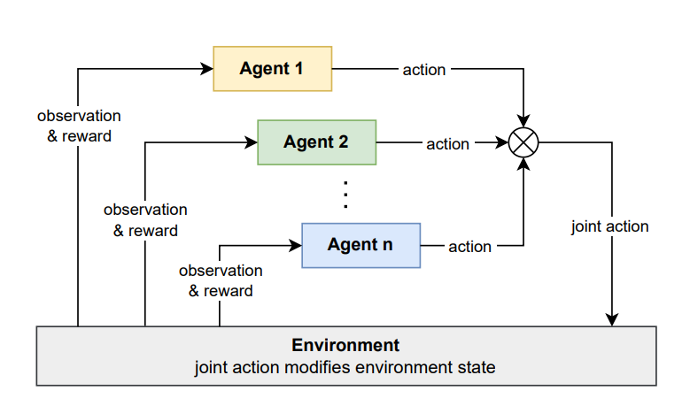
Multi-agent RL for Agent Re-tasking
Notes:
A set of n agents choose individual actions, which together are referred to as the joint action. The joint action changes the state of the environment according to the environment dynamics, and the agents receive individual rewards as a result of this change, as well as individual observations about the new environment state. This loop continues until a terminal criterion is satisfied (such as one agent winning a game of chess) or indefinitely.

Slide 6
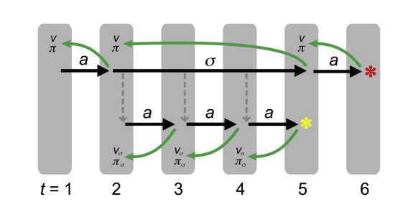
Hierarchical Reinforcement Learning
Notes:
A Neural Signature of Hierarchical Reinforcement Learning Jose´ J.F. Ribas-Fernandes, Alec Solway, Carlos Diuk, Joseph T. McGuire, Andrew G. Barto, Yael Niv, and Matthew M. Botvinick
At t1, a primitive action (a) is selected. Based on the consequent state, an RPE is computed (green arrow from t2 to t1), and used to update the action policy (p) for the preceding state, as well as the value (V) of that state (an estimate of the expected future reward, when starting from that state). At t2 a subroutine (s) is selected and remains active through t5. Until then, primitive actions are selected as dictated by s (lower tier). A PPE (Pseudo-reward Prediction Error) is computed after each (lower green arrows from t5 to t2), and used to update the subroutine-specific action policy (ps) and state values (Vs). These PPEs are computed with respect to pseudo-reward received at the end of the subroutine (yellow asterisk). Once the subgoal state of s is reached, s is terminated. An RPE is computed for the entire subroutine (upper green arrow from t5 to t2), and used to update the value and policy, V and p, associated with the state in which s was initiated. A new action is then selected at the top level, yielding primary reward (red asterisk).

Slide 7
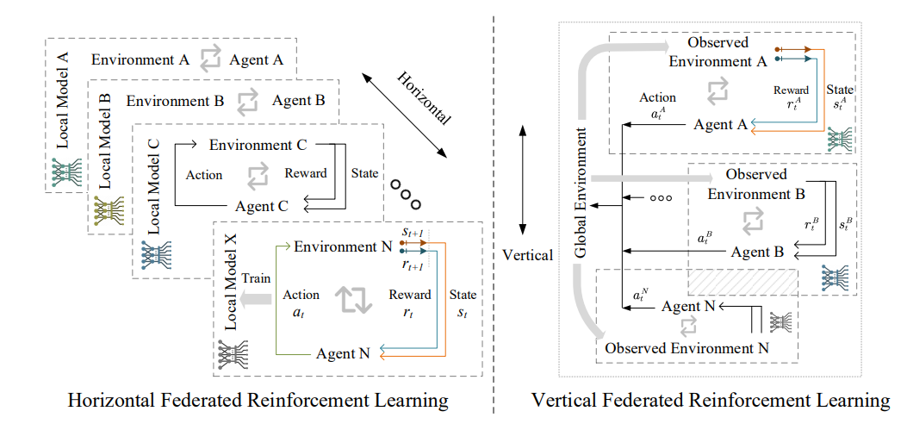
Federated Reinforcement Learning
Notes:
In HFRL, the environment that each agent interacts with is independent of the others, while the state space and action space of different agents are aligned to solve similar problems.
The action of each agent only affects its own environment and results in corresponding rewards. As an agent can hardly explore all states of its environment, multiple agents interacting with their own copy of the environment can accelerate training and improve model performance by sharing experience.
Therefore, horizontal agents use server-client model or peer-to-peer model to transmit and exchange the gradients or parameters of their policy models (actors) and/or value function models (critics).
In VFRL, multiple agents interact with the same global environment, but each can only observe limited state information in the scope of its view. Agents can perform different actions depending on the observed environment and receive local reward or even no reward. Based on the actual scenario, there may be some observation overlap between agents. In addition, all agents’ actions affect the global environment dynamics and total rewards

